Slide 1
Customer Segmentation Case Study with R
Implementing K Means Clustering
CII

Slide 2
Contents
The k Means Algorithm
Segmentation using k Means
Summarizing the k Means output
Strategic Business Decisions

Slide 3
The k Means Algorithm

Slide 4
k means – Clustering
What is k means clustering ?
Start
k-means clustering aims to partition n observations into k clusters in which each observation belongs to the cluster with the nearest mean, serving as a prototype of the cluster.
Number of clusters – ‘k’
Centroid
Yes
Group Move Possible?
Why is K means – so popular in Data Mining ?
No
Simple, easy to implement
Easy to interpret the clustering results
Fast and efficient in terms of computational cost
Object distance to centroid
Grouping based on minimum distance
End

Slide 5
k means clustering – An example
Centroid 1
Centroid 2
Iteration - Zero
Business Need: Group the Medicines
in k = 2 groups
D
C
A
B
Distance Matrix at Iteration 0
A B C D
Group Matrix at Iteration 0
Re- Group – Based on Min Distance

Slide 6
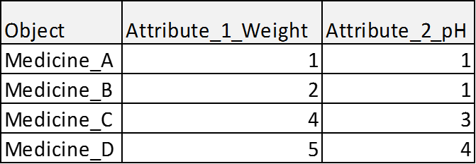
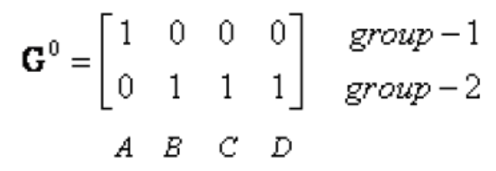
k means contd.
Iteration – One
Recompute Group Centroids
Group 1 has only 1 member
Group 2 has 3 members
Centroid 1
Centroid 2
Group Matrix after Iteration One
D
Distance Matrix after Iteration One
C
A
B

Slide 7
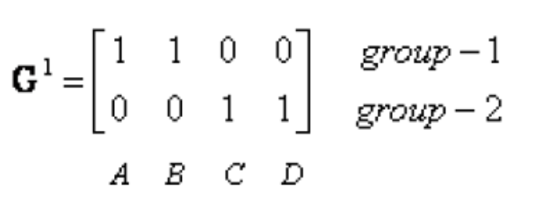
k means contd.
Iteration – Two
Recompute Group Centroids
Centroid 2
Group Matrix after Iteration Two
Centroid 1
D
Distance Matrix after Iteration Two
C
A
B
G2 = G1
Iteration Stops .
Final Grouping established

Slide 8
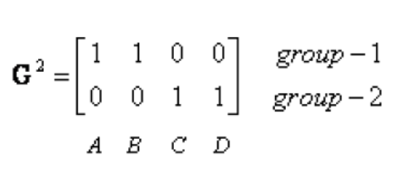
k means contd.
Input file
# Read the data file
kmeansData<- read.csv(file='INPUT_k_means.csv', header=T, sep=',')
######## Setting k = 2 #############
k <- 2
# Calling kmeans R function
kc <- kmeans(kmeansData, k)
A B C D
Clustering vector: [1] 2 2 1 1

Slide 9
Segmentation using k Mean Algorithm

Slide 10
Process Flow
Performing
k means
in R
Choosing optimal segments
Generate Clustering Vector
Summarize Clustered data
Business decisions

Slide 11
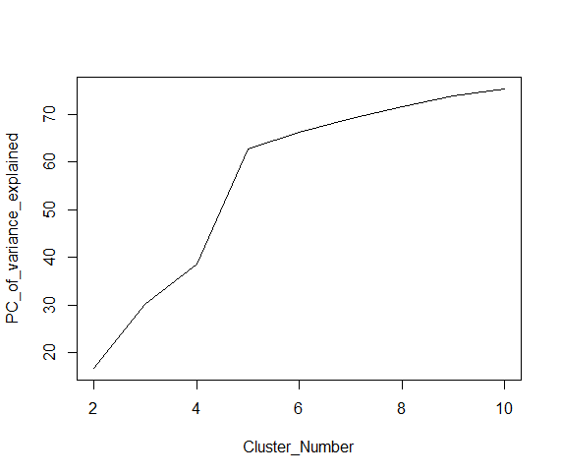
Optimal Cluster Size Determination
Objective of the k-means clustering is used to minimize the within cluster distance and maximize the between cluster distance.
K-means expects user to specify number of centers
Elbow method is used to choose optimal center
data_after_cor<-Agg_data[,c(1:5,7,9:10)]
Scaled_data<-scale(data_after_cor[,c(-1,-8)])
set.seed(4)
kr<-NULL
for(k in 2:10)
{
xk<-kmeans(Scaled_data,k,iter.max=200)
print(xk$betweenss/xk$totss*100)
kr<-c(kr, xk$betweenss/xk$totss*100)
}
kr
plot(c(2:10),kr,type='l',xlab="Cluster_Number",ylab="PC_of_variance_explained")

Slide 12
Optimal Cluster Size Determination
Cluster # | Customer % | Rev % | Avg_Freq | Avg_Recency | Avg_Weekend_spend | Avg_Weekend_visits
1 | 44 | 18 | 14 | 11 | 1170 | 5
2 | 31 | 9 | 8 | 31 | 884 | 4
3 | 10 | 58 | 49 | 10 | 21331 | 30
4 | 15 | 15 | 10 | 10 | 1239 | 4
Cluster 3 can be profiled as high value segment.
58% revenue is generated by 10% of customer base

Slide 13
Probable Strategic Business Decisions
Giving privileged customer status to High Revenue share customer segment (as per analysis 10%) for their retention
Customizing marketing campaigns for lower revenue share customer segment (as per analysis 31%) so as to increase their share of wallet
Modify the product portfolios by introducing low cost products for the lower revenue share customer segments to increase their revenue share

Slide 14
Thank You

